Slide 1

Self-driving in Duckietown environment
Tensór.Tesók
Kerekes Márton
Blazsek Péter
Sárdi Ferenc Zsolt

Slide 2

Goals - Motivation
Learn about Reinforcment learning
About self driving cars
Explore Duckietown environment
Train own self-driving car

Slide 3

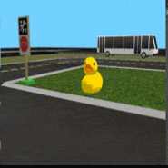
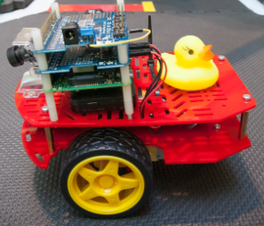
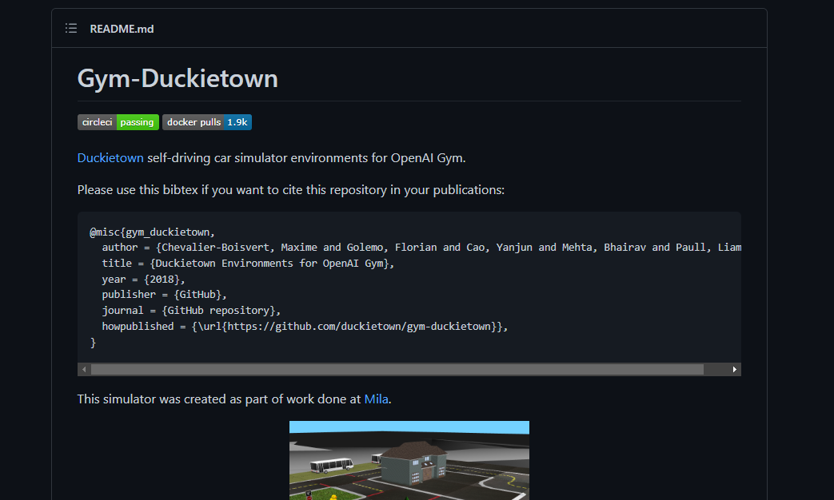
Duckietown environment
„Duckietown is a computational ecosystem for tangible and accessible state-of-the-art learning experiences in robotics and AI.”
Driving with only one camera
Virtual environment for testing without real hardware
AI Driving Olympics (AI-DO)
Several implementation methods for the challenges
Paull, L., Tani, J., Ahn, H., Alonso-Mora, J., Carlone, L., Cap, M., ... & Censi, A. (2017, May). Duckietown: an open, inexpensive and flexible platform for autonomy education and research. In 2017 IEEE International Conference on Robotics and Automation (ICRA) (pp. 1497-1504). IEEE.
Schulman, J., Wolski, F., Dhariwal, P., Radford, A., & Klimov, O. (2017). Proximal policy optimization algorithms. arXiv preprint arXiv:1707.06347.

Slide 4

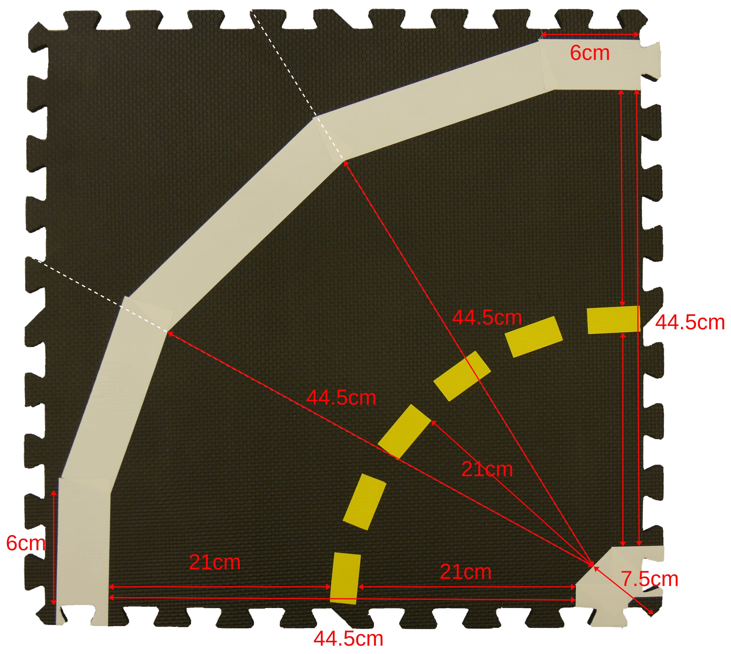
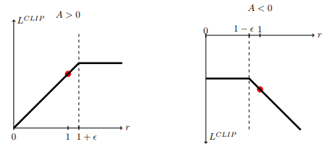
Implementation
Reinforcment Learning libary – Ray lib
Custom wrappers – Reward, Crop, Discrete
Algoritms – PPO, IMPALA

Slide 5
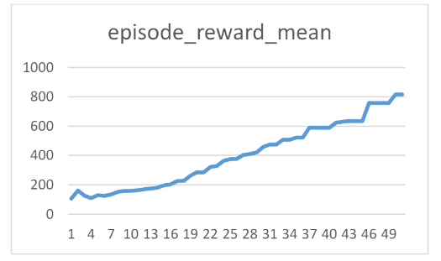
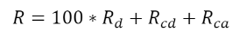
Results
Rewards converge
Hyperparameter optimization
Proximal Policy Optimization
Learning rate: 0.0001- 5e-6
Batch size: 1500 | 2000
The PPO clipping: 0.28 - 0.32
SGD batch size: 150 | 200

Slide 6
Summary - difficulties
Self-driving car in the Duckietown environment
Custom wrappers and training with PPO
Car stuck in a circling
Difficult to set up the environment(version/modul conflict)
Ghosting members

